Slide 1

Social Psychology
Chapter 13

Slide 2
Chapter 13 Learning Objective Menu
LO 13.1 Conformity
LO 13.2 Groupthink
LO 13.3 Four ways to gain compliance
LO 13.4 Obedience
LO 13.5 Influence of presence of others on task performance
LO 13.6 Components and formation of an attitude
LO 13.7 How attitudes can be changed
LO 13.8 When attitudes do not match actions
LO 13.9 Social categorization and implicit personality theories
LO 13.10 How people explain others’ actions
LO 13.11 Prejudice and discrimination
LO 13.12 Why people are prejudiced and how to stop it
LO 13.13 Factors that cause attraction
LO 13.14 Love and the different forms of love
LO 13.15 Biology and learning influences on aggression
LO 13.16 Altruism
LO 13.17 Bystander effect
LO 13.18 Latané and Darley’s discovery on helping behavior
LO 13.19 Decisions before helping occurs
LO 13.20 Why people join cults

Slide 3
Social Psychology and Conformity
LO 13.1 Conformity
Social psychology – the scientific study of how a person’s thoughts, feelings, and behavior are influenced by the real, imagined, or implied presence of others.
Social influence - the process through which the real or implied presence of others can directly or indirectly influence the thoughts, feelings, and behavior of an individual.
Conformity - changing one’s own behavior to match that of other people.
Menu

Slide 4
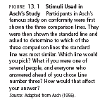
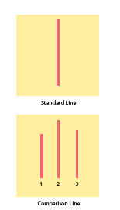
LO 13.1 Conformity
Menu

Slide 5
Groupthink and Compliance
LO 13.2 Groupthink
Groupthink - kind of thinking that occurs when people place more importance on maintaining group cohesiveness than on assessing the facts of the problem with which the group is concerned.
Consumer psychology – branch of psychology that studies the habits of consumers in the marketplace, including compliance.
Compliance - changing one’s behavior as a result of other people directing or asking for the change.
Menu

Slide 6

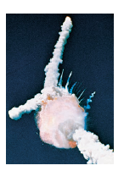
LO 13.2 Groupthink
Menu

Slide 7
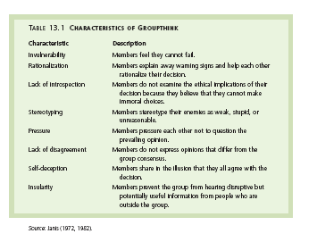
LO 13.2 Groupthink
Menu

Slide 8
Four Ways to Gain Compliance
LO 13.3 Four ways to gain compliance
Foot-in-the-door technique – asking for a small commitment and, after gaining compliance, asking for a bigger commitment.
Door-in-the-face technique – asking for a large commitment and being refused, and then asking for a smaller commitment.
  Norm of reciprocity - assumption that if someone does something for a person, that person should do something for the other in return.
Menu

Slide 9

Four Ways to Gain Compliance
LO 13.3 Four ways to gain compliance
Lowball technique – getting a commitment from a person and then raising the cost of that commitment.
That’s-not-all technique - a sales technique in which the persuader makes an offer and then adds something extra to make the offer look better before the target person can make a decision.
Menu

Slide 10
Obedience
LO 13.4 Obedience
Obedience - changing one’s behavior at the command of an authority figure.
Milgram study – “teacher” administered what they thought were real shocks to a “learner.”
Menu

Slide 11
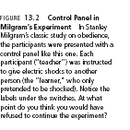
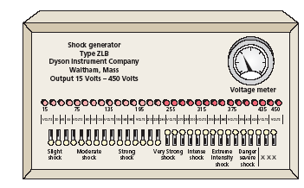
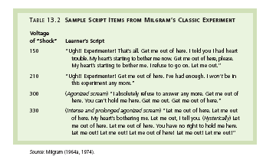
LO 13.4 Obedience
Menu

Slide 12
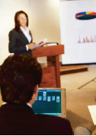
Social Loafing and Social Facilitation
LO 13.5 Influence of presence of others on task performance
Social facilitation - the tendency for the presence of other people to have a positive impact on the performance of an easy task.
Social loafing - the tendency for people to put less effort into a simple task when working with others on that task.
Menu

Slide 13
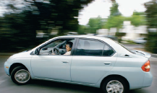
Attitudes
LO 13.6 Components and formation of an attitude
Attitude - a tendency to respond positively or negatively toward a certain person, object, idea, or situation.
The three components of an attitude are the affective (emotional) component, the behavioral component, and the cognitive component.
Attitudes are often poor predictors of behavior unless the attitude is very specific or very strong.
Menu

Slide 14
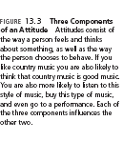
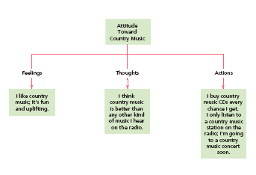
LO 13.6 Components and formation of an attitude
Menu

Slide 15

Formation of Attitudes
LO 13.6 Components and formation of an attitude
Direct contact with the person, situation, object, or idea.
Direct instruction from parents or others.
Interacting with other people who hold a certain attitude.
Watching the actions and reactions of others to ideas, people, objects, and situations.
Menu

Slide 16

Persuasion
LO 13.7 How attitudes can be changed
Persuasion - the process by which one person tries to change the belief, opinion, position, or course of action of another person through argument, pleading, or explanation.
  Key elements in persuasion are the source of the message, the message itself, and the target audience.
Menu

Slide 17
Persuasion
LO 13.7 How attitudes can be changed
Elaboration likelihood model – model of persuasion stating that people will either elaborate on the persuasive message or fail to elaborate on it, and that the future actions of those who do elaborate are more predictable than those who do not.
  Central-route processing - type of information processing that involves attending to the content of the message itself.
  Peripheral-route processing - type of information processing that involves attending to factors not involved in the message, such as the appearance of the source of the message, the length of the message, and other noncontent factors.
Menu

Slide 18

Cognitive Dissonance
LO 13.8 When attitudes do not match actions
Cognitive dissonance - sense of discomfort or distress that occurs when a person’s behavior does not correspond to that person’s impression formation the forming of the first knowledge that a person has concerning another person.
  Lessened by changing the conflicting behavior, changing the conflicting attitude, or forming a new attitude to justify the behavior.
Menu

Slide 19
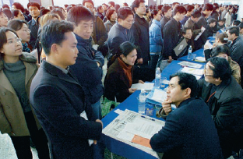
Social Cognition and Impressions
LO 13.8 When attitudes do not match actions
Social cognition - the mental processes that people use to make sense of the social world around them.
Impression formation - forming of the first knowledge a person has about another person.
  Primacy effect - the very first impression one has about a person tends to persist even in the face of evidence to the contrary.
Menu

Slide 20
Social Cognition and Social Categorization
LO 13.9 Social categorization and implicit personality theories
Social categorization - the assignment of a person one has just met to a category based on characteristics the new person has in common with other people with whom one has had experience in the past.
  Stereotype - a set of characteristics that people believe is shared by all members of a particular social category.
Menu

Slide 21
Social Cognition and Social Categorization
LO 13.9 Social categorization and implicit personality theories
Implicit personality theory - sets of assumptions about how different types of people, personality traits, and actions are related to each other.
Schemas - mental patterns that represent what a person believes about certain types of people. Schemas can become stereotypes.
Menu

Slide 22
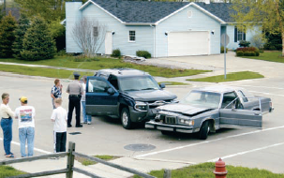
Attributions
LO 13.10 How people explain others’ actions
Attribution - the process of explaining one’s own behavior and the behavior of others.
Attribution theory - the theory of how people make attributions.
  Situational cause- cause of behavior attributed to external factors, such as delays, the action of others, or some other aspect of the situation.
  Dispositional cause - cause of behavior attributed to internal factors such as personality or character.
Menu

Slide 23
Attributions
LO 13.10 How people explain others’ actions
Fundamental attribution error (actor-observer bias) – the tendency to overestimate the influence of internal factors in determining behavior while underestimating situational factors.
Menu

Slide 24
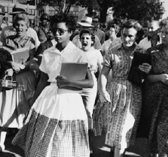
Prejudice and Discrimination
LO 13.11 Prejudice and discrimination
Prejudice - negative attitude held by a person about the members of a particular social group.
Discrimination - treating people differently because of prejudice toward the social group to which they belong.
Forms of prejudice include ageism, sexism, racism, and prejudice toward those who are too fat or too thin.
Menu

Slide 25
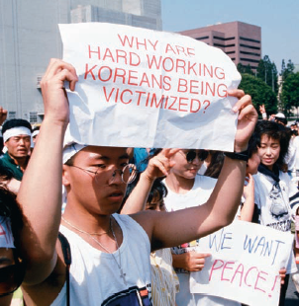
Prejudice and Discrimination
LO 13.11 Prejudice and discrimination
In-groups - social groups with whom a person identifies; “us.”
Out-groups - social groups with whom a person does not identify; “they.”
Realistic conflict theory - conflict between groups increases prejudice and discrimination.
Scapegoating - tendency to direct prejudice and discrimination at out-group members who have little social power or influence.
Menu

Slide 26
Stopping Prejudice
LO 13.12 Why people are prejudiced and how to stop it
Social cognitive theory – views prejudice as an attitude acquired through direct instruction, modeling, and other social influences.
Social identity theory – theory in which the formation of a person’s identity within a particular social group is explained by social categorization, social identity, and social comparison.
  Social identity - the part of the self-concept including one’s view of self as a member of a particular social category.
  Social comparison – the comparison of oneself to others in ways that raise one’s self-esteem.
Menu

Slide 27
Stopping Prejudice
LO 13.12 Why people are prejudiced and how to stop it
Stereotype vulnerability - the effect that people’s awareness of the stereotypes associated with their social group has on their behavior.
Self-fulfilling prophecy - the tendency of one’s expectations to affect one’s behavior in such a way as to make the expectation more likely to occur.
Menu

Slide 28

Stopping Prejudice
LO 13.12 Why people are prejudiced and how to stop it
Equal status contact - contact between groups in which the groups have equal status, with neither group having power over the other.
“Jigsaw classroom” - educational technique in which each individual is given only part of the information needed to solve a problem, causing the separate individuals to be forced to work together to find the solution.
Menu

Slide 29
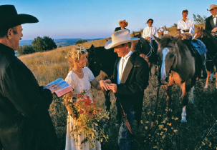
Attraction
LO 13.13 Factors that cause attraction
Interpersonal attraction - liking or having the desire for a relationship with another person.
Proximity - physical or geographical nearness.
People like people who are similar to themselves OR who are different from themselves (complementary).
Reciprocity of liking - tendency of people to like other people who like them in return.
Menu

Slide 30
Love
LO 13.14 Love and the different forms of love
Love - a strong affection for another person due to kinship, personal ties, sexual attraction, admiration, or common interests.
Sternberg states that the three components of love are intimacy, passion, and commitment.
Romantic love - type of love consisting of intimacy and passion.
Companionate love - type of love consisting of intimacy and commitment.
Menu

Slide 31
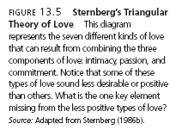
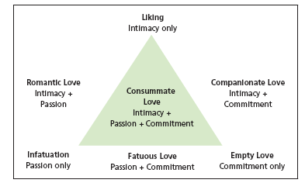
LO 13.14 Love and the different forms of love
Menu

Slide 32
Aggression
LO 13.15 Biology and learning influences on aggression
Aggression - behavior intended to hurt or destroy another person.
Biological influences on aggression may include genetics, the amygdala and limbic system, and testosterone and serotonin levels.
Social role - the pattern of behavior that is expected of a person who is in a particular social position.
  Violent TV, movies, and videos are related to aggression.
Menu

Slide 33
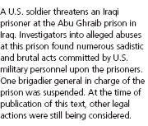
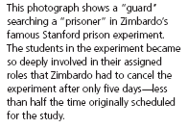
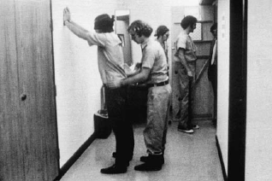
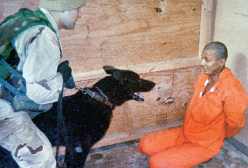
LO 13.15 Biology and learning influences on aggression
Menu

Slide 34
Altruism
LO 13.16 Altruism
Prosocial behavior - socially desirable behavior that benefits others.
Altruism - prosocial behavior that is done with no expectation of reward and may involve the risk of harm to oneself.
Menu

Slide 35

Bystander Effect
LO 13.17 Bystander effect
Bystander effect - referring to the effect that the presence of other people has on the decision to help or not help, with help becoming less likely as the number of bystanders increases.
Diffusion of responsibility - occurring when a person fails to take responsibility for actions or for inaction because of the presence of other people who are seen to share the responsibility.
Menu

Slide 36
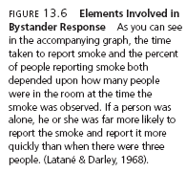
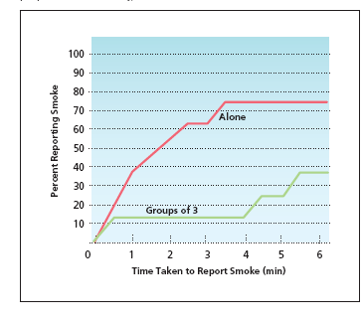
LO 13.17 Bystander effect
Menu

Slide 37
Diffusion of Responsibility
LO 13.18 Latané and Darley’s discovery on helping behavior
Researchers Latané and Darley found that people who were alone were more likely to help in an emergency than people who were with others.
  One bystander cannot diffuse responsibility.
Menu

Slide 38
Five Steps in Making a Decision to Help
LO 13.19 Decisions before helping occurs
Noticing
Defining an emergency
Taking responsibility
Planning a course of action
Taking action
Menu

Slide 39
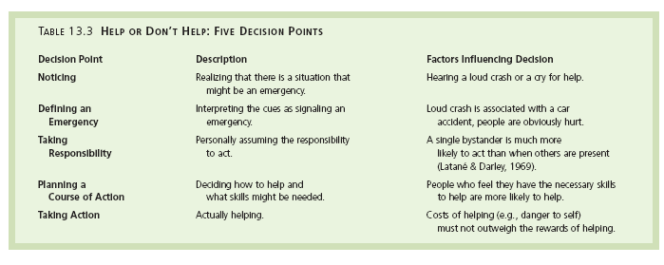
LO 13.19 Decisions before helping occurs.
Menu

Slide 40
Cults
LO 13.20 Why people join cults
People who join cults tend to be under stress, unhappy, unassertive, gullible, dependent, want to belong, and idealistic.
Young people are likelier to join cults than are older people.
Cults use love-bombing, isolation, rituals, and activities to keep the new recruits from questions and critical thinking.
Menu

Slide 41
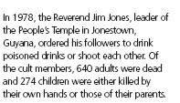
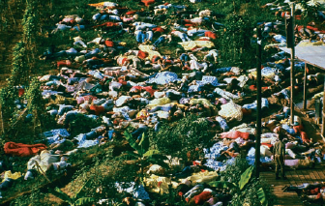
LO 13.20 Why people join cults
Menu

